Slide 1
For Inspiration and Recognition of Science and Technology
How To Utilize Mentors In Creating A Winning FRC Team
Rex Brown
#1730 Team Driven Mentor

Slide 2

Agenda

Slide 3
What it is Not
It Is Not About the Robot!

Slide 4

WHO?
Mentor
Notes:
The graphic represents that a mentor is to guide and assist the student.

Slide 5


What is a FIRST Mentor?
mentor:
Function: noun
Etymology: Latin, from Greek Mentōr
Date: 1616
1 capitalized: a friend of Odysseus entrusted with the education of Odysseus' son Telemachus
2 a: a trusted counselor or guide b: tutor, coach
(Via: Merriam Webster Online Dictionary)
Be the Guard Rails
Notes:
Talk about analogy from ChiefDelphi that a mentor is like the guard rails on a road. When the students effects are minimal the guardrail is non-existent or way off the road. As cost goes up or delivery is getting close the guard rail narrows down.

Slide 6
What is a FIRST Mentor
The Vision of FIRST Programs:
"To transform our culture by creating a world where science and technology are celebrated and where young people dream of becoming science and technology heroes."
A FIRST mentor personifies this vision!
Be the HERO!

Slide 7
What is a FIRST Mentor
A mentor to a team is:
An extension of the team sponsor/head coach
  Extra eyes, ears, hands, feet
  Technical support/augmentation
  Network entrance point
An implementer of the team vision
  Works toward the same goals
  Helps to deliver a consistent message
Be on the same page!

Slide 8
What is a FIRST Mentor
A Mentor:
  Can be a person of any age, teaching others what they know
  Brings either technical or non technical expertise to the team
  Provides the opportunity for students to learn directly through experiences
  Begins as a teacher, evolves into a colleague
  Knows that Mentoring and Coaching is about inspiring and guiding
  Provides students the environment to succeed
  Is patient, supportive, enthusiastic, compassionate and available
  Remembers what’s important – it’s about the kids and they come first

Slide 9
Responsibilities:
Inspire the students in science and technology
Motivate and engage students in meaningful activities
Create open communication within the team
Facilitate instruction
Maintain process focus
Have the students do as much work as possible
Establish an environment conducive to open and honest communication
Show trust in, and respect for, every team member and his/her ideas
Encourage accountability

Slide 10
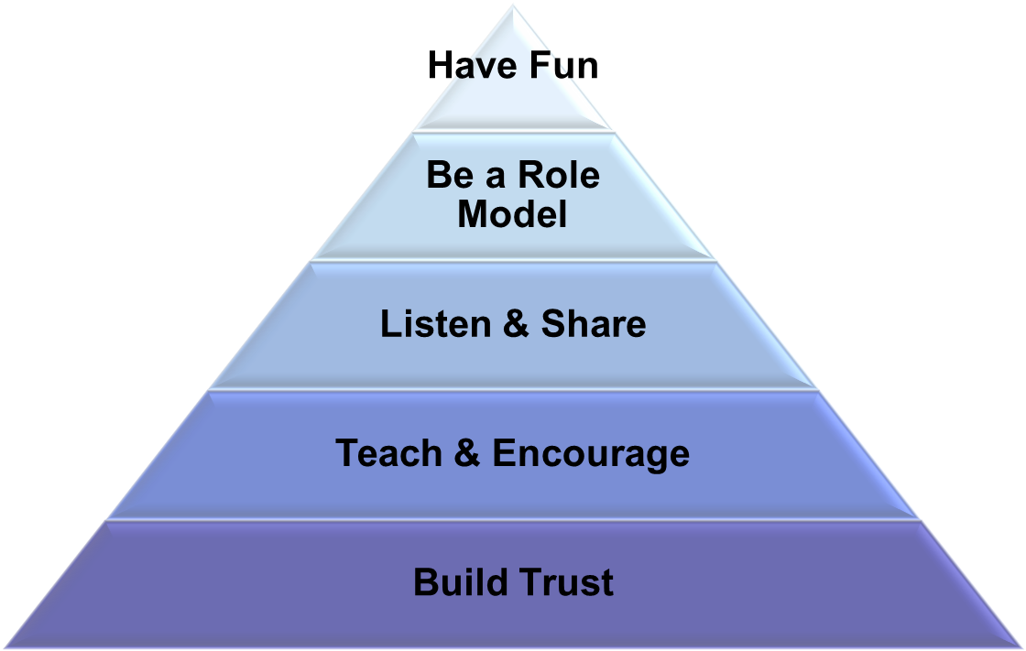
Pyramid to Fun

Slide 11
Where to use Mentors
  Engineering
  Building/Manufacturing
  Computer Aided Design (CAD) (Software Depending on Team)
    Inventor
    Pro-E
    Solidworks
  Computer Programming
    NI Labview
    C++
    Java
    Animation (AutoDesk 3ds Max)
Notes:
The slide is meant to show both the engineering/science and the financial/project management side.

Slide 12
Where to use Mentors
  Marketing
    Team Branding
    Presentations
    News letters
  Website Design
  Project Management
    Team Management
    Travel
    Team Building

Slide 13
When to use mentors
Keep Mentors Involved on a high level, in all aspects of the team
  Mentors like being involved and want to participate
  They may not be expert on a topic but most have great networks
Keep mentors focused on area of expertise
Don’t spread them too thin
Notes:
Keep Mentor involved on a high level. Keep them focused on area of expertise (Don’t have the engineer leading the car wash fund raiser). Watch for burn out in mentors by not spreading them to thin.

Slide 14
Why Utilize Mentors
Establish networks
Gain professional support and encouragement
Receive honest and informal feedback
Gain competency in technical issues and new technologies
Expand growth and gain exposure to new ideas, theories, practices
Save time and money by avoiding 'reinventing the wheel
Secure future resource(s) for advice and ideas
Notes:
Establish Networks - Both for Coach and Kids, Kids receive sources for letter’s of recommendation for scholarship, leads for summer employment, internships and full time jobs.
Professional Support and Encouragement - Place to bounce ideas and get encouragement
The rest are self explanatory.

Slide 15
How?
Get Mentors early in the process
  Invite every one you know to the kickoff every year, Parents, Local Business’s & Friends
  Don't turn away mentor help unless the mentor is detrimental to the team
Set up Ground Rules for Mentors
  A couple of key mentors should be role models for the other mentors.
  Remember it is about the Kids and not the mentors
  FIRST mentors need to realize that they are being role models
  Decide if mentors need to be disciplinarians on those rare cases
Notes:
A team should have some sort of a plan for certain mentors to be the disciplinarians while most other mentors not have to deal with these rare "problems". Most teams signify a teacher or two to handle these issues, while the engineering mentors are not mired in those issues.

Slide 16
How?
Schedule meeting and build times
  Mentors have day jobs
Have fun. Let the kids show you how to loosen up and have fun.
Empower kids to show off their skills
Encourage the mentors to meet socially, without the kids present
Notes:
Empower kids to show off their skills. Model for students how to be mentored by each other and the kids when someone knows something you want to learn.
Encourage the mentors to meet socially, without the kids present. This allows for mentor-mentor trust and friendship to bloom, and helps set the foundation for a long sustaining team.

Slide 17

How Mentors Transfer Ownership
I Do / You Watch
I Do / You Help
You Do / I Help
You Do / I Watch

Slide 18

How to Communicate
Keep Communications open between Team and mentors
Determine communication methods early
  Kids don’t e-mail
  Many adult’s don’t text
Set up meeting time between Coach and mentors (without kids around)
If mentor had student on team and student graduates don’t automatically think the mentor wants to stop helping.

Slide 19

Q&A

Slide 20
Remember
It Is Not About the Robot!

